Slide 1
Web Programming 1
Week 2 Worksheet

Slide 2
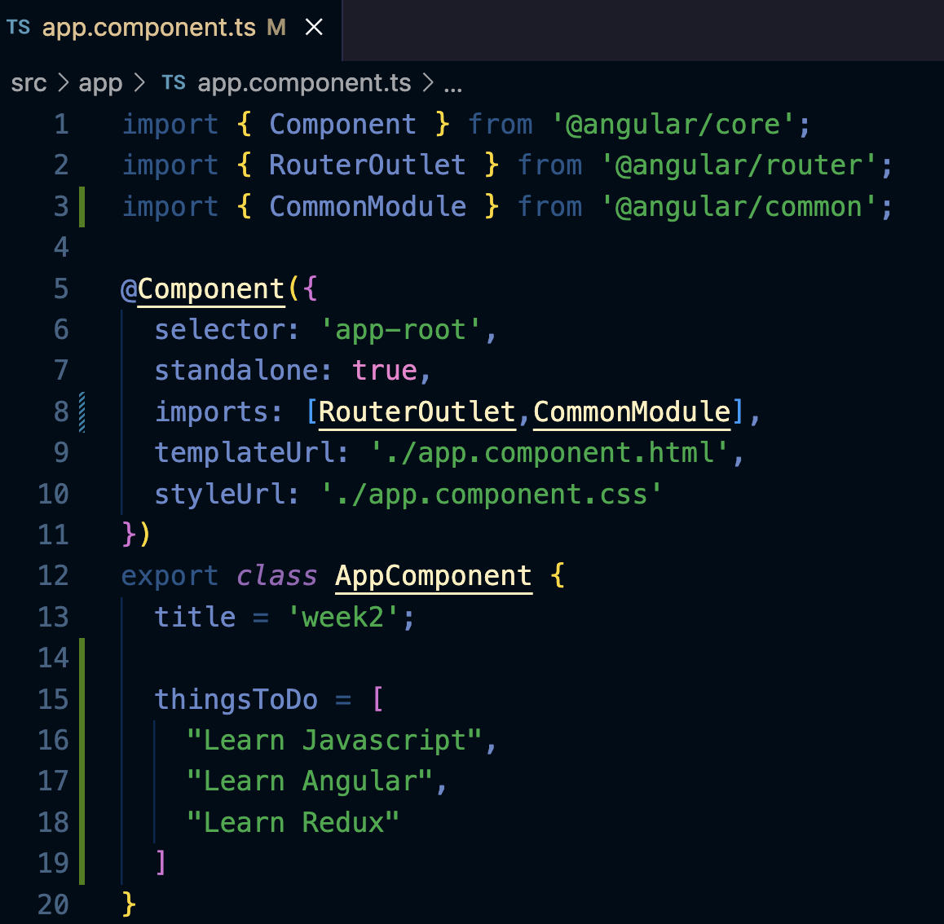
Example of *ngFor directive
Let’s say we have an array called thingsToDo
Use *ngFor directive to loop to recurse through the array
Interpolate and display the data in the array

Slide 3
Looping through an array
We create an array called thingsToDo
Use an Angular for loop to recurse through the data (*ngFor)
Interpolate and display the data

Slide 4
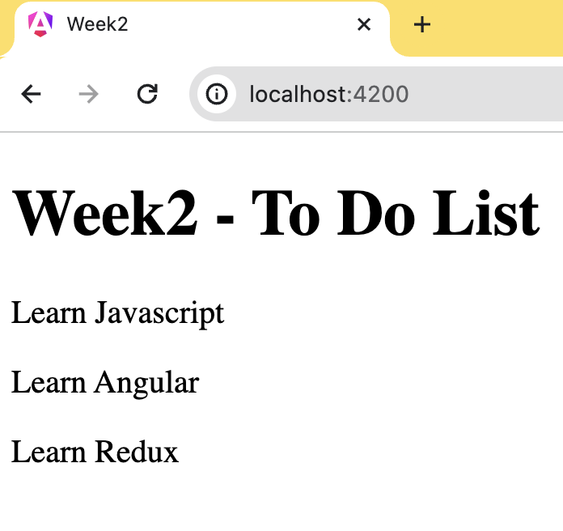
Example of *ngFor directive
Use *ngFor to repeat some HTML multiple times
The loop variable item is created locally

Slide 5
Displaying Data
Change the title
Add a list of strings

Slide 6
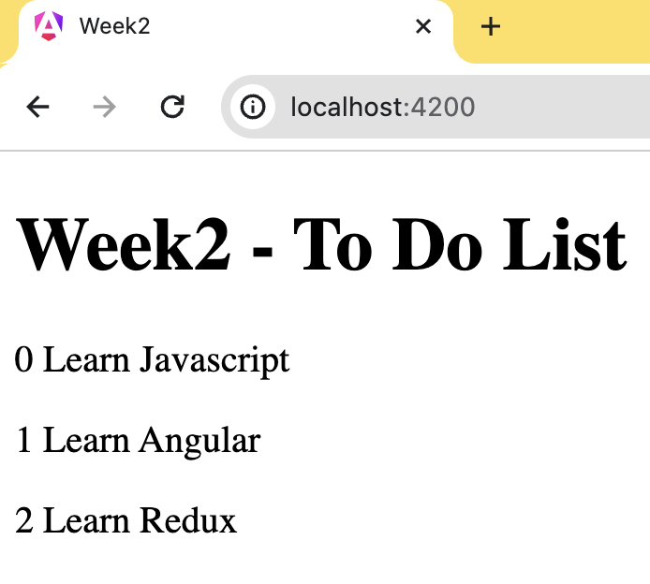
For Loop - *ngFor
*ngFor Exports Useful Values
We can obtain the 0-based index of each iteration and assign the value to a local variable:

Slide 7
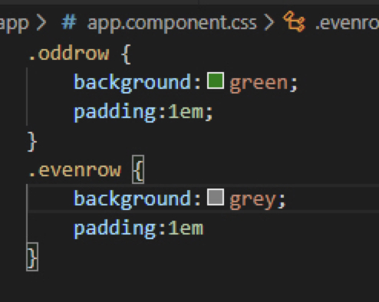
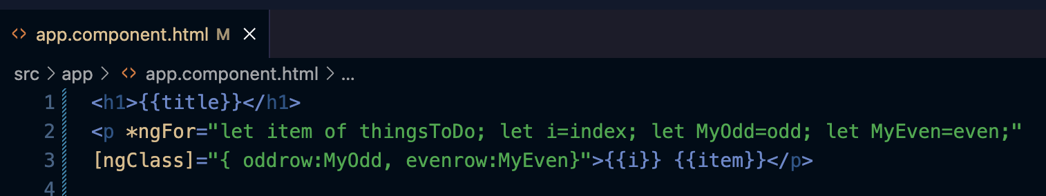
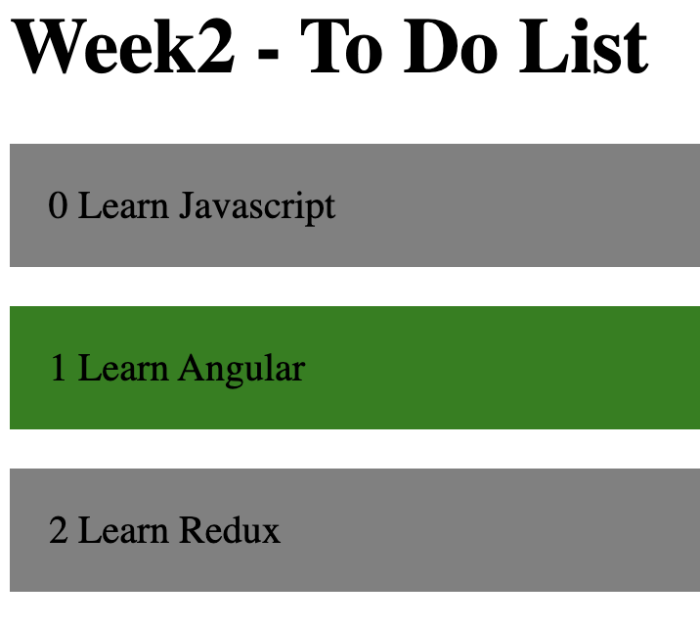
For Loop - *ngFor
Similarly, *ngFor exports first, last, even and odd Booleans which can also be assigned to local variables.
These could be used for differing class colours to rows in a table (e.g. oddrow, evenrow)
ngClass is an attribute directive that adds or removes CSS classes on a html element
Here the classname (oddrow/evenrow will only be used if condition if odd or even is true

Slide 8
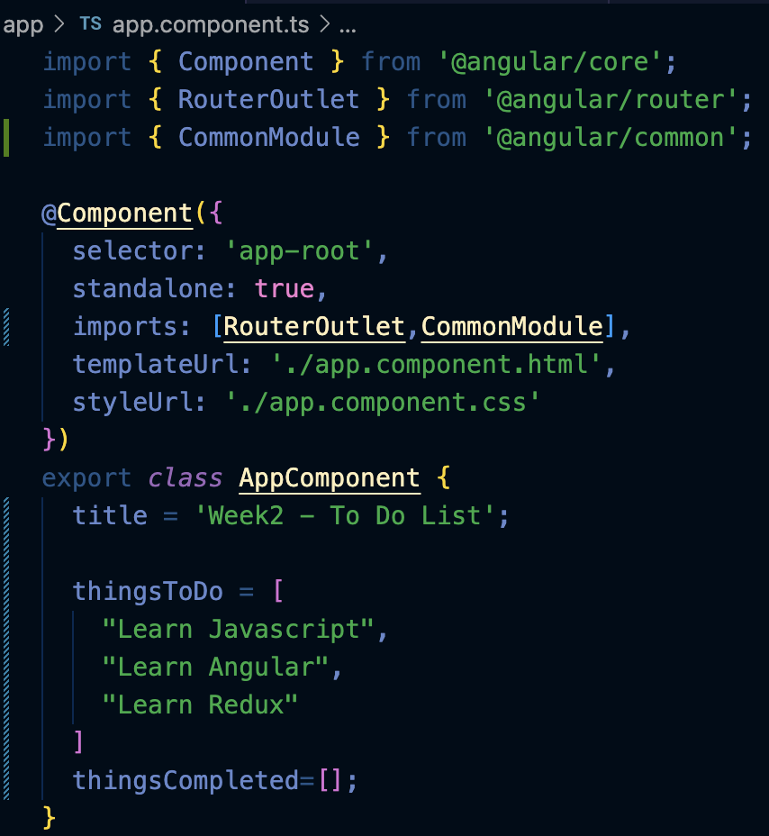
IF Statement - *ngIf
Use *ngIf to control whether or not something is displayed
More precisely, whether or not something is added to the DOM
See how to show and hide content with styles later
In the AppComponent class, we add an empty array thingsCompleted

Slide 9
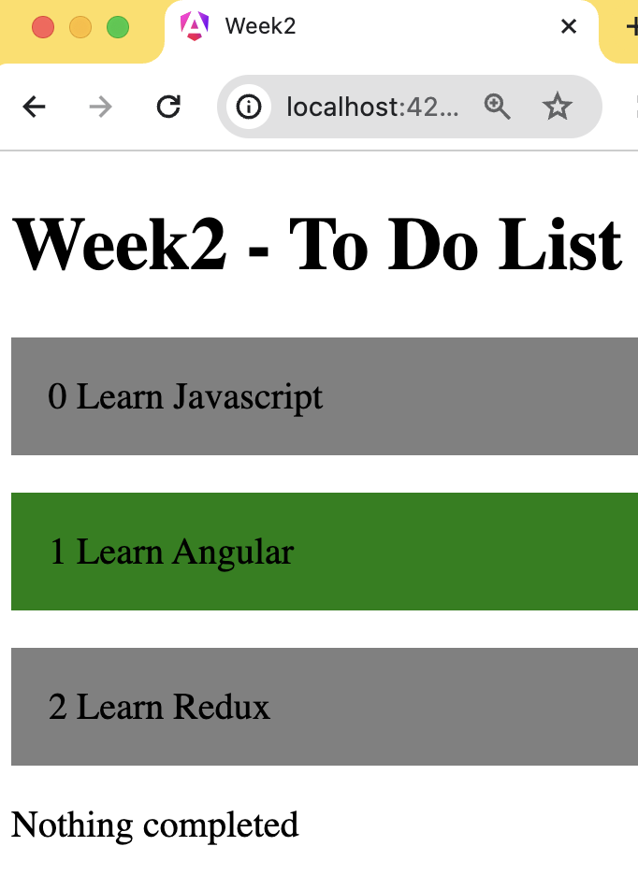
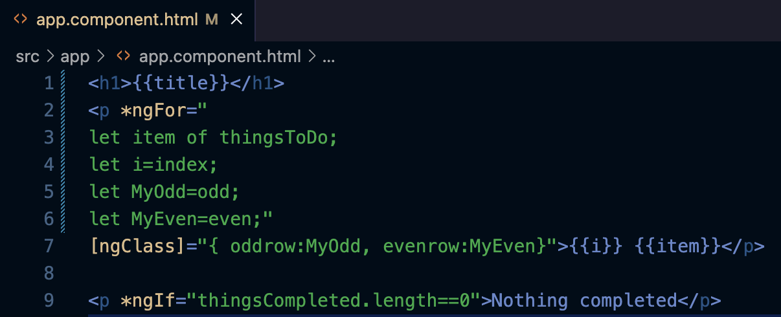
IF Statement - *ngIf

Slide 10
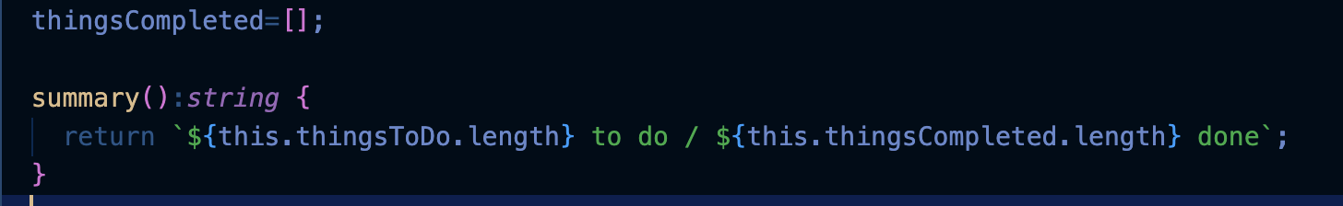
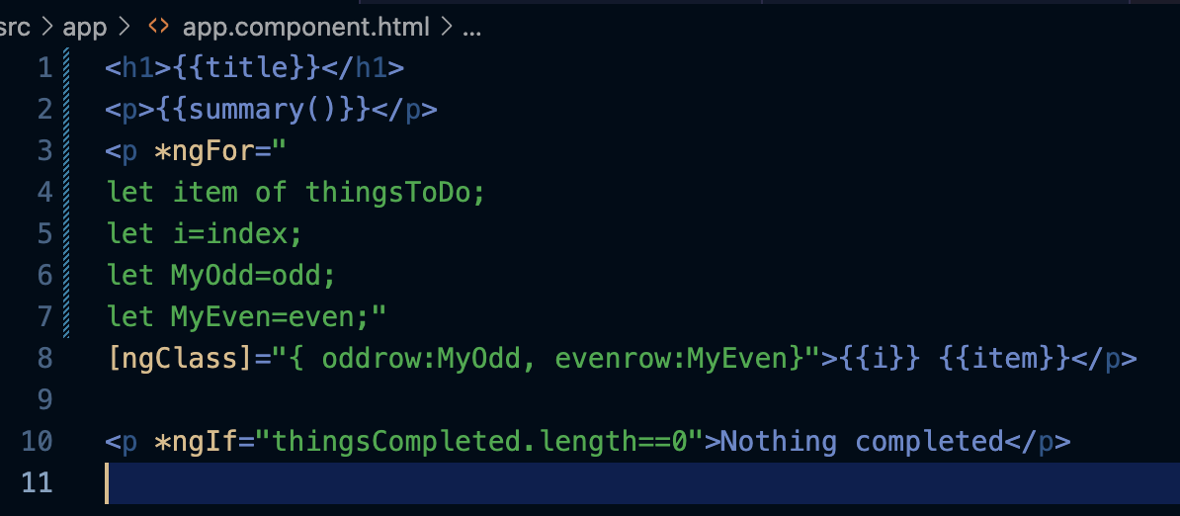
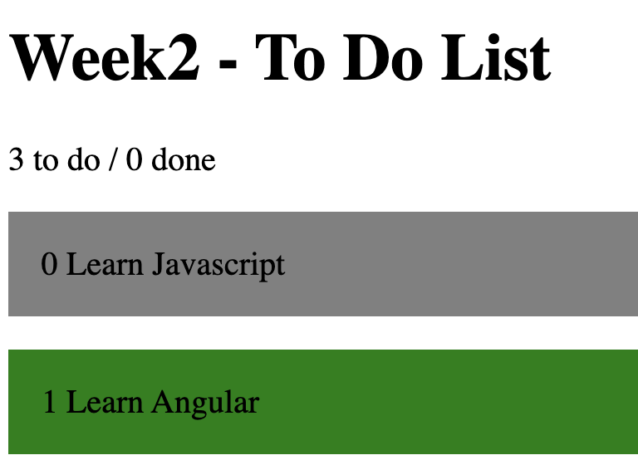
Dynamic Content
Interpolated expressions can include function and method calls
Example of template literal - text
enclosed with backticks – string
interpolation with embedded
expression

Slide 11
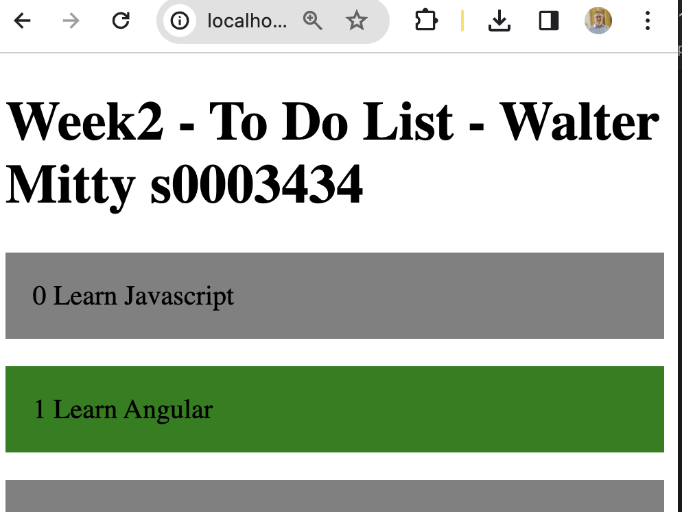
Upload Week2
Screenshot your work – add your name and student id to app.component.html
Add this screenshot to /src/app
Push to github
Goto your repository, click “Code” and choose to ”Download Zip”
Upload this zip file to Moodle

